Slide 1
MVVM Pattern
Windows Phone Application

Slide 2
Misconception
MVVM pattern is often misunderstood. Sometimes people talk about commanding, behaviors, messaging, service locators and other technology features into MVVM. While these are powerful and great features, they're not MVVM; they're helpers you can choose to use with MVVM.
So, can you use MVVM without these features? Absolutely.

Slide 3
Hello MVVM
MVVM is an architectural pattern
Solution to a general problem
Adapted from the “Presentation Model” pattern

Slide 4
Why Use MVVM
Separate UI/Business/Data logic
Able to swap out UI
Unit Testing
Write less UI code
Developer & Designer can work parallel
Make it easier to maintain and reuse code

Slide 5
Building blocks of MVVM

Slide 6
The Model
Contains the data points that the application requires
It is your data or classes that represent entities in your application
No reference to ViewModel

Slide 7
The View
Represents the user interface that the user will see
Can be a page, user control or Data Template
Keep it simple
-- Clean code-behind
-- Only visual logic (all the rest should go in the
ViewModel)
Should never contain anything that is to be tested
--- Model Related
In MVVM, views should be expressed primarily in XAML
-- Code-behind contains only InitializeComponent() plus
UI code that’s impractical to represent in XAML or
requires direct references to UI controls

Slide 8
The ViewModel
It is the glue between the View and the Model(s)
it exposes public properties intended for the View
Interacts with the model(s)
Manages the flow of the application
No control references!
Should not contain “view properties” such as Color
-- Use converters for this
Must be testable
Notifies view of property/state changes
Essentially consists of code that would typically be found in code-behind + logic involving loading, saving, and preparing model data for display

Slide 9
One doubt
Do I need a ViewModel for every View that I made or is there any one to one relationship between View and ViewModel?
The answer is No.

Slide 10
MVVM Diagram
View
Data Binding
Command
Event
ViewModel
Model
Model
Model

Slide 11
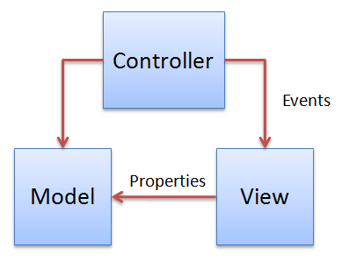
MVC Diagram

Slide 12
What we get out of this
View knows nothing about Model
Model knows nothing about View
Model knows nothing about ViewModel
ViewModel knows nothing about View
View knows ViewModel
You can easily replace View without affecting the ViewModel
At last they are all loosely coupled
We can maintain code easily
We can test ViewModel code separately
Reduces repetitive code by using data binding

Slide 13
Linking the View and ViewModel

Slide 14
Linking the View and ViewModel
DataBinding
Command
Events
Message

Slide 15
DataBinding
Data binding is the glue but…
A view needs to “find” its ViewModel
ViewModel is the DataContext
Can be static or dynamic
Static: View creates ViewModel and sets it as DataContext
Dynamic: at runtime, View selects its ViewModel or vice-versa
2 options:
View-First: ViewModel gets created because View is created
ViewModel-First: ViewModel is created and View gets selected

Slide 16
NotifyPropertyChanged
public interface INotifyPropertyChanged
{
event PropertyChangedEventHandler PropertyChanged;
}
public abstract class NotifyHelper : INotifyPropertyChanged
{
public event PropertyChangedEventHandler PropertyChanged;
protected void RaisePropertyChanged(string propertyName)
{
var handler = PropertyChanged;
if (handler != null)
{
handler(this, new ropertyChangedEventArgs(propertyName));
}
}
}

Slide 17
Commands
Instead of writing event handling code for button clicks, we bind the buttons (or MenuItems) in the View to Commands in the ViewModel.
We do it by implementing ICommand interface
It has following members
-- CanExecute (property)
-- CanExecuteChanged (event)
-- Execute()
Supported on ButtonBase class (and therefore all controls that derive from it) and HyperlinkButton only.
Rest of the control needs to use behaviors

Slide 18
Command Pattern
public interface ICommand
{
bool CanExecute(object param);
void Execute(object param);
event EventHandler CanExecuteChanged;
}
public class DelegateCommand : ICommand
{
public DelegateCommand(
Action<object> command,
Predicate<object> canExecute);
}

Slide 19
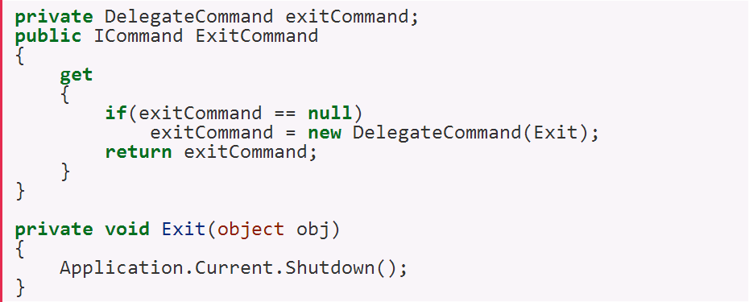
Command Pattern
<Button Name="btnExit" Command="{Binding ExitCommand}"

Slide 20
Behaviors
Block of code that we can attach to XAML element
Useful in MVVM scenarios on controls that don’t support commanding
Avoids having code in code-behind
Supported by Blend
Not supported by Windows 8 ☹

Slide 21
Third Party Support(MVVM Framework)
Prism
MVVM Light
Caliburn

Slide 22
Useful links
http://msdn.microsoft.com/en-us/library/windowsphone/develop/gg521153(v=vs.105).aspx
http://msdn.microsoft.com/en-us/magazine/dd419663.aspx
http://aka.ms/WinPhoneMVVM1
http://aka.ms/WinPhoneMVVM2
http://aka.ms/WinPhoneMVVM3

Slide 23
Thank You

